Slide 1
Role of banking in India and Credit creation in post reforms period
Project by: Group - 7
Arjun Borkhatariya – 1401015
Nisarg Tike – 1401070
Ravi Limbad – 1401077
Falgun Prajapati – 1401080
Kedar Acharya – 1401081
Anuj Shah – 1401084
Shloak Agarwal – 1401105
Arjun Sanchala - 131004

Slide 2
Role of banking in India

Slide 3
The primary activity of banks is
“accepting deposits, for the purpose of
lending and investment, deposits of
money”.
The essence of banking is TRUST.

Slide 4
Phases of Indian Banking system
The first bank in India was established in 1786. The Indian Banking System can be classified into 2 phases.
1. Post-Nationalization - 1969 - 1991.
2. Post-Liberalization – New phase of Indian Banking System with the advent of Indian Financial and Banking Sector Reforms after 1991.

Slide 5
Role of Bank in Indian Economy
Promote capital formation
Promote trade and industry
Development of Agricultural sector
Development of foreign trade
Balanced development of different regions
Implementation of monetary policy

Slide 6
Capital Formation
Capital formation is a measure of the net additions to the capital stock of a country in an accounting interval.
Banks encourage the habit of saving among people.
Thus idle resources are mobilized for production purposes.

Slide 7
Promotion of trade and industry
Industrial development needs huge finance.
In developing countries like India, commercial banks grant short-term and medium-term loans to industries.

Slide 8
Development of Agricultural sector
In an agricultural economy like India, majority of population lives in rural area and is dependent on small scale industries.
Thus, banks uplift the rural population by granting short-term and long-term loans for the development of small scale agro-based industries

Slide 9
Development of foreign trade
Foreign trade in India includes all imports and exports to and from India.
India exports approximately 7500 commodities to about 190 countries, and imports around 6000 commodities from 140 countries.
Since the liberalization, India's economy has improved mainly due to increased foreign trade.

Slide 10
Implementation of monetary policy
The central bank controls the supply of money by its control over interest rates in order to maintain price stability and achieve high economic growth.
The RBI sets the CRR(cash reserve ratio) in the form of reserves. As of September 2015, the CRR is 4.00%.

Slide 11
Balanced development of different regions
Banks transfer surplus capital from the developed regions to the less developed regions, where it is scarce and most needed.
This reallocation of funds between regions promotes economic development in underdeveloped areas.

Slide 12
Credit Creation in post reforms period

Slide 13
What is credit creation?
Credit is defined as the claim to receive payments. When a bank gives loans to people, then the bank becomes a lender and the person who takes loan from the bank is called a borrower. When bank gives loan today it also makes arrangements to recover the same from the person in future. This means that the bank can claim the money from the borrower in future. Accordingly, the bank is able to expand its deposits. This is called credit creation by the bank. Thus, credit is created through the act of lending and borrowing.
The cash reserve ratio (CRR) remains a powerful instrument of monetary policy in India as well as in most of the developing economies.

Slide 14
CRR Process
Let CRR be 10%. Therefore excess ratio r = 0.9.
Suppose A deposits Rs. 1000 in a bank. Now, the bank can lend at most Rs. 900. Thus the total credit it can lend is,
900 + 810 + 729 + … = 900/(1-r) = 9000
→Higher the CRR, lower would be r and hence lower credit creation.

Slide 15
CRR
Steps | Increase in Deposit | Cash Reserve | Loan
1 | 1000 | 100 | 900
2 | 900 | 90 | 810
3 | 810 | 81 | 729
… | … | … | …
… | … | … | …
Total | 10000 | 1000 | 9000

Slide 16
Before Liberalization
The root causes behind the dull performance of banking sector in pre-reforms period:
Greater emphasis on directed credit programmes
Regulated interest rate structure
Excessive regulations on organization's structure and managerial resources
Lack of focus on profitability
Lack of competition
Lack of proper Accounting and Risk Management System
Lack of operational transparency
Excessive support from government

Slide 17
Reforms by Narasimham Committee in 1991
Reduction in pre-emption of funds through reduction of CRR and SLR
Deregulation of interest rates
Infusion of competition (Entry of Private Sector Banks)
Imparting transparency
Introduction of universal banking
Development of technology
Emphasis on corporate governance

Slide 18
Impact of the reforms
The Indian banking registered tremendous growth in the post-liberalization era.
There has been a drastic change in the rules, regulation, organization and activity level of Indian financial sector.
It has shifted from regulated to de-regulated market economy and defined a new role for the banks.
All these reforms have changed the Indian banking market from ‘Sellers market’ to ‘Buyers market’.

Slide 19
CRR and SLR
CRR limits the ability of the banks to pump more money into the economy.
SLR is used to limit the expansion of bank credit, for ensuring the solvency of banks (even if all the loans by the bank go bad, the bank can still retrieve a part of it by selling the gold/govt securities). As of now, the CRR and SLR rates are 4% and 21.5% respectively. Hence, the bank can only use 100-4-21.5= 74.5% of its total deposits for the purpose of lending.

Slide 20
Impact of CRR on Indian Economy
Situation: Economy has inflationary trend. Prices of goods and services increasing every day.
Solution: RBI raised reserve ratio (CRR, SLR)
Result: SBI is left with less money to lend.
Consequences:
SBI raises its loan interest rate
Businessmen borrow less money from SBI
Businessmen do not start new business. Do not expand existing business
Result=Less jobs. Even existing employees discharged. If anyone remains in the job, he doesn’t get pay raise. He starts cutting down unnecessary expenditure (e.g. buying two newspapers, getting his shirts ironed, drinking tea @4PM in office and so on. Thus even paper-wall, dhobi, chai-walla- everyone’s income reduced.)
Result= Less income (Because of above reasons)
Result= Less demand of goods and services (because less income).
Ultimately shopkeeper will bring down the prices to attract people into buying more things.
Thus inflation is reduced
Thus to fight inflation Reserve Ratio is increased and to fight deflation it is decreased

Slide 21
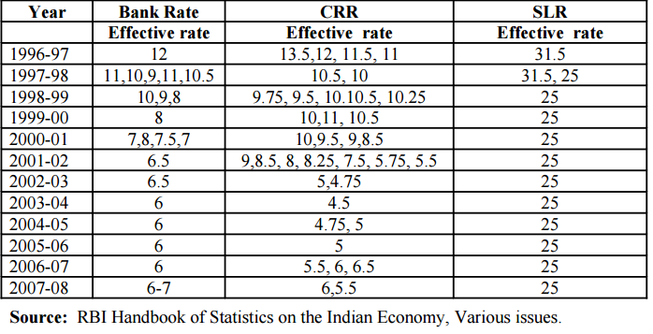
CRR and SLR effective rate

Slide 22
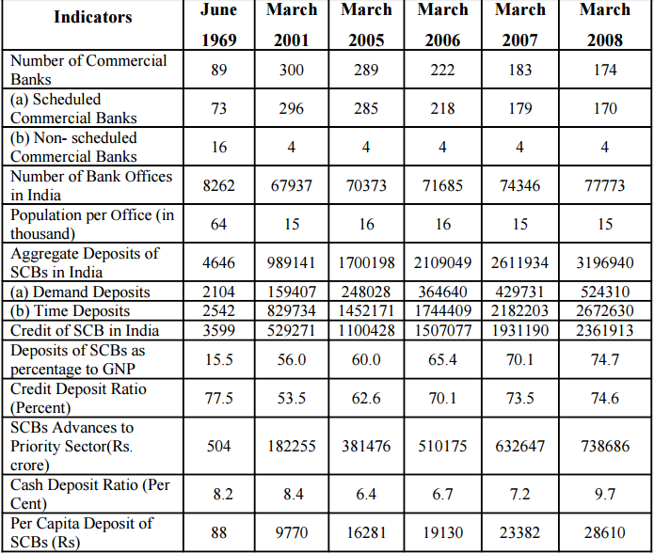
Cash Deposit Ratio

Slide 23
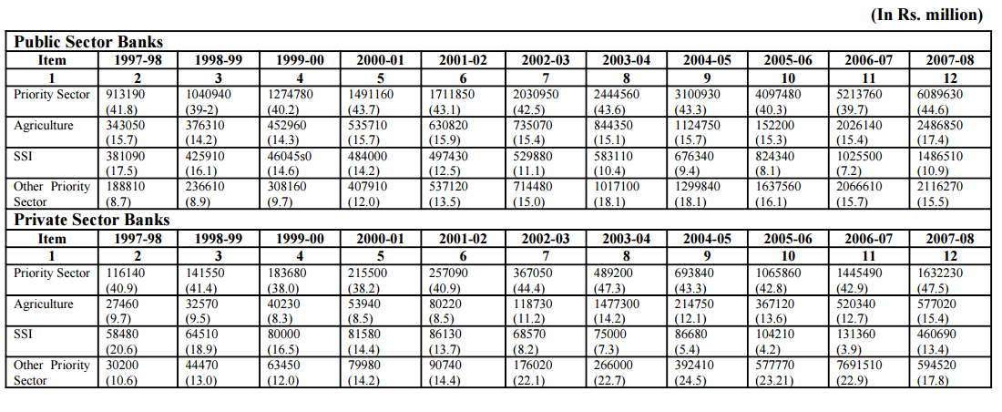
Loans given by public sector banks to various sectors (in Rs. Million)

Slide 24
Conclusion
The banking system in India has undergone significant changes during the last two decades.
Deregulation has opened up new ways for banks to generate income.
The government took steps to reduce its ownership in nationalised banks and inducted private ownership.

Slide 25
References
http://shodhganga.inflibnet.ac.in/bitstream/10603/2875/12/12_chapter%204.pdf
https://en.wikipedia.org/wiki/Narasimham_Committee_on_Banking_Sector_Reforms_(1998)
http://www.yourarticlelibrary.com/banking/commercial-banks-7-important-role-of-commercial-banks-in-a-developing-country/10968/

